Slide 1
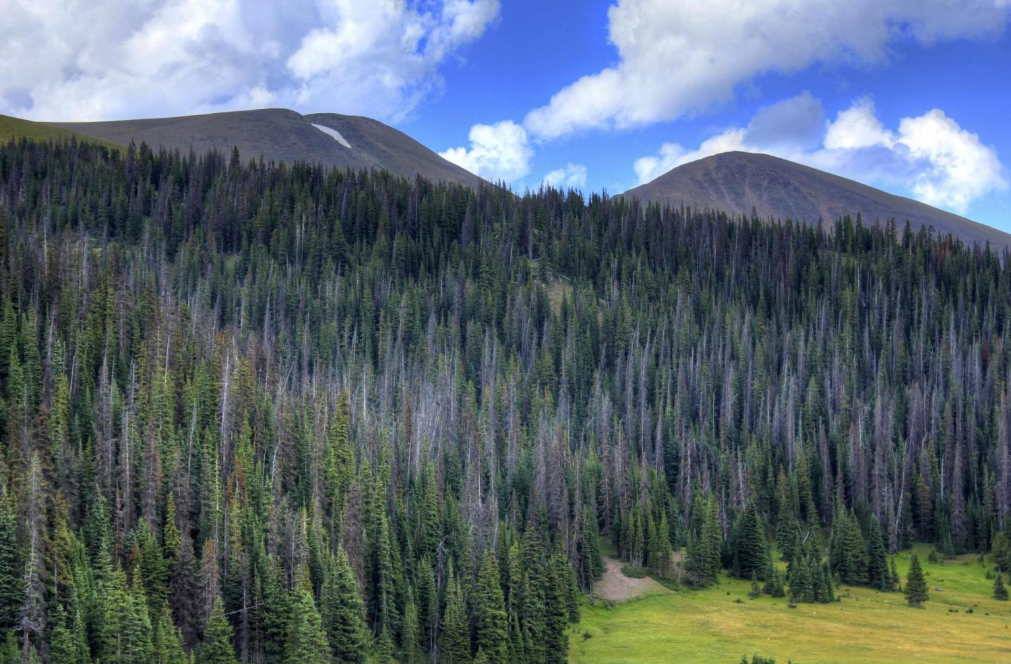
Analysis of Boulder’s Trees
Katherine Best, Thomas Martinez, Jacob Fiola

Slide 2
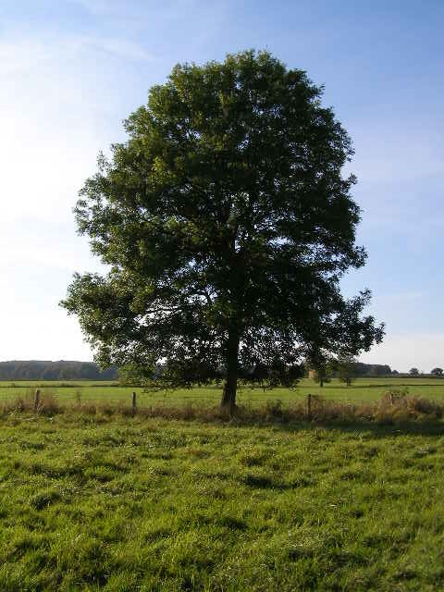
Motivation
Create a low dimensional model for the health of trees.
Predict the condition of trees.
Create a new understanding for the well being of trees.
Also because we need these to live...

Slide 3
Data
About 1,000 trees
39 columns originally
About 370 columns after data processing
Notes:
We have a dataset from the city of Boulder that has information about approximately 1,000 trees. Originally it had 39 columns containing information about the location, type, maintenance required, etc. Then we take columns like these and turn them into indicator columns. This leaves us about 370.

Slide 4
Methods
PCA
Backward selection
Hybrid methods
Notes:
We do PCA and then pick the first 20 PCA basis vectors.
Then we do backwards selection until we have 20 of our original features as a comparison point.
Then we created some hybrid methods that take some of the original feature vectors, feed the rest into PCA, and then take some of the best resulting PCA vectors

Slide 5
Results

Slide 6
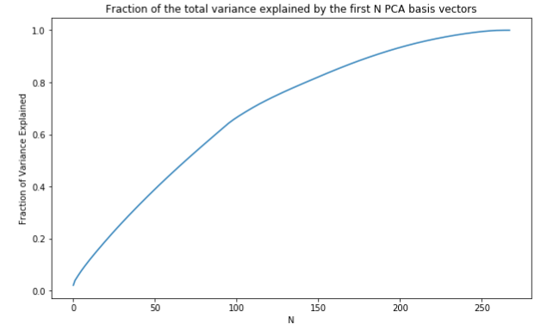
Principal Components
Notes:
It is surprising that we get a lower R2 value for the regression performed on the data in the 20-dimensional PCA basis than the regression done on the 20 best features found using backward selection.
But if we think about how these two methods work, we can see that this is not so surprising after all. Recall that the 20 PCA basis vectors will be in the directions that maximize the variance of the data, so we can think of them as the vectors that best explain the variance in the data. However, when we do backwards selection, we are picking the features that best account for the variance in the response.
This distinction between what kind of variance we are maximizing allows us to realize why we might be getting this kind of behavior. There could be directions that have high variance but are not predictive of the condition of the trees. In this case, PCA vectors in these directions will not be useful in the model, even though they do well at explaining the variance of the data and will be among the first vectors in the PCA basis.

Slide 7
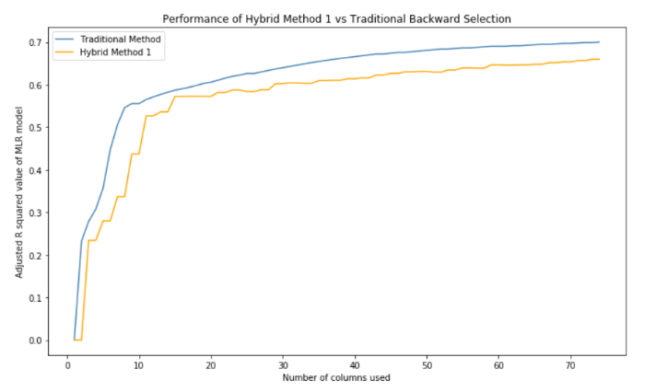
Hybrid Method 1
Notes:
After observing the last results, it is not surprising that we got a lower adjusted $R^2$ value for hybrid method 1 when using 1 - 200 columns.
This is because we observed that the top 20 PCA basis columns were not as predictive as the top 20 columns from traditional backwards selection.

Slide 8
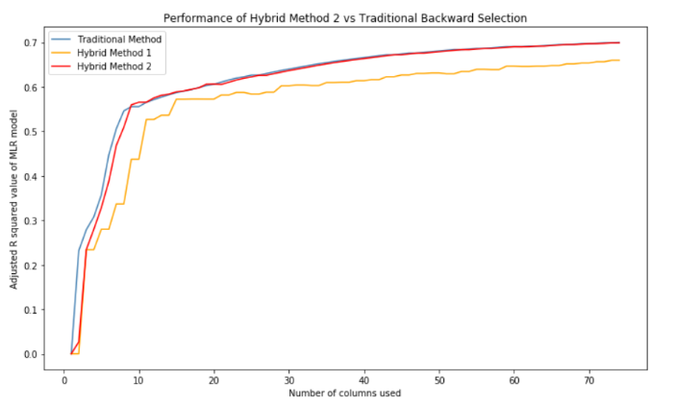
Hybrid Method 2
Notes:
It is apparent that hybrid method 2 actually predicts the condition of trees better than traditional backwards selection when there are 7, 8 or 9 columns being used. It seems that these cases of out-performing backwards selection are, however, few and far between.
So, why is this occurring? When we use hybrid method 2, we are still at least considering the rest of the "unimportant" columns. On the other hand, backwards selection literally drops columns that do not predict the response enough.
Because of these results, one could argue that it might be more predictive to take into account all the data in some way, even if it is expressed in a single column appended to the most important columns.

Slide 9
Top 10 features, by importance
DBH - Diameter at breast height - (-) correlation
No Specific Maintenance Need - (+) correlation
Safety Prune - (+) correlation
Structure Prune - (+) correlation
Treat Pest - (+) correlation
Remove Stakes - (+) correlation
Other - See Notes - (+) correlation
crown dieback (disease) - (-) correlation
Acer saccharinum - (-) correlation
Silver Maple - (-) correlation
Notes:
Silver Maple an Acer saccarinum are the same

Slide 10
Questions?

